Slide 1
ONLINE SHOPPING SITES RESEARCH AND ANALYSIS (FOCUSING ON ONLINE SHOPPING BEHAVIOUR)

Slide 2
INTRODUCTION
Aim
The project aim is to investigate the effects of various features and new technologies on web-based shopping sites and the effects on the behavior of shoppers.
Objects
To assess the effects of design and functionality factors on customers’ experience and their choice of a particular product.
To determine the extent to which emerging technologies have helped in making online shopping better.
To establish the factors that influence consumer interaction and satisfaction with online shopping websites.
To offer a practical course of action that can be implemented on online shopping sites about the research.
Notes:
1.2 Research Background
E-shopping has become an integral aspect of modern retailing globally which is enhanced by the use of technology as well as consumers’ changing preferences. The increased use of mobile devices and the internet to make purchases has put the consumer in possession of a vast choice of products as well as services hence changing the retail environment. These advancements have birthed several forms of e-commerce with various methodologies to observe and maintain consumers. This paper discusses several aspects such as user perspective, technicalities, and promotional aspects in this realm of research (Saoula et al. 2023). Past research has identified several important aspects, including site design, searching capabilities, and customization as important drivers for consumer behaviour. Well-designed site maps and search options improve site usability and increase consumer satisfaction in buying products. Personalization, on the other hand, customizes shopping to personal preferences which might lead to more interactions and the resulting conversion. Thus, it becomes critical to examine such factors as IT developments in the e-commerce environment. In particular, AI and AR, and shifts in customer preferences influence the efficacy and productivity of e-commerce platforms. This exploration helps to understand how these factors affect users’ engagement and site effectiveness.
1.3 Research Rationale
This kind of research rationale is derived from the emergence of new online buying and selling and the need for enterprises to keep up with the changing market forces. With the increased use of digital platforms for consumers’ shopping, awareness of the features that motivate users and affect their decisions is even more important. After discussing present e-commerce research efforts in detail, a profound deficit in understanding the impact of specific site characteristics. Also, newer technologies on both user experience and site performance remain apparent (Fadillah and Kusumawati, 2021). This is particularly important to fill the gap of delivering insights that may help online shopping sites improve their layout and performance.
This gap is examining the effects of features and technology on consumers’ experiences with online shopping sites. Such elements are crucial to discovering significant findings that can contribute to improving user experience and customer satisfaction and ultimately lead to business development. Furthermore, with increased focus on individualism and increased incorporations of new technologies, provides additional comprehension of the various tendencies affecting the consumers and the website results. Finally, it is expected that the results of the study will be useful in enhancing the effectiveness of online shopping sites.

Slide 3
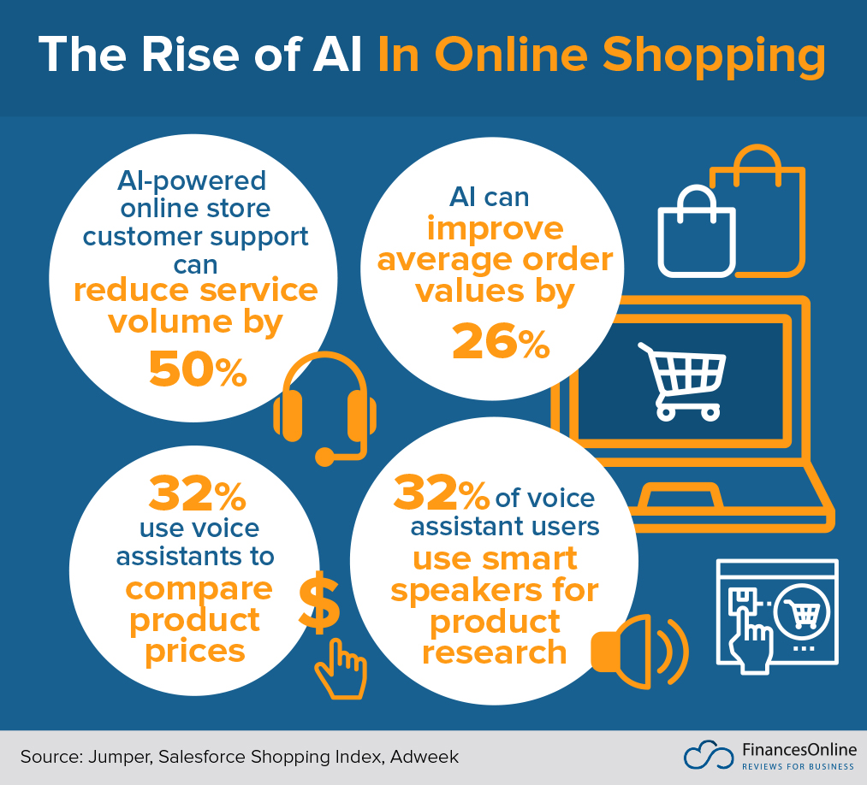
INTRODUCTION
Research Significance
This research is important as it discusses the facets of or relating to online shopping sites that affect both the business persons and the users.
These research findings are useful in highlighting strategies that may help in enhancing shopping websites.
The implications offer insights to improve the overall online strategy, user experience, and customer satisfaction.
Consumers benefit from the research by gaining insight into how the online shopping environment can be modified to suit their expectations.
Notes:
1.6 Research Significance
This research is important as it discusses the facets of or relating to online shopping sites that affect both the business persons and the users. These research findings are useful in highlighting strategies that may help in enhancing shopping websites. The implications offer insights to improve the overall online strategy, user experience, and customer satisfaction. Such changes can result in additional sales production and cultivated and enhanced competitive position in the continually progressing environment for e-business. Consumers benefit from the research by gaining insight into how the online shopping environment can be modified to suit their expectations. The opportunities of the future and advanced technologies, including artificial intelligence and augmented reality, show how innovation can enhance the purchase journey in online shops (Ismagilova et al. 2020). This study points to the potential of directing the design and operations of digital retail sites to accommodate the needs of today’s consumers and support business success. Furthermore, it contributes to the understanding of the online shopping concept and contributes to future developments in this area.
1.8 Summary
This chapter begins the research on online shopping sites and describes the significance of their effects on consumer behavior with the help of newer technologies. These include the research background, rationale, aim, objectives, and significance which form the basis for a detailed evaluation of digital retail platforms. Again, the chapter outlines the research questions as well as the flow of the research; therefore, creates the direction of the study. Thus, by considering these aspects, the research seeks to contribute to improving consumers’ online shopping experience and increasing the efficiency of e-retail initiatives.

Slide 4
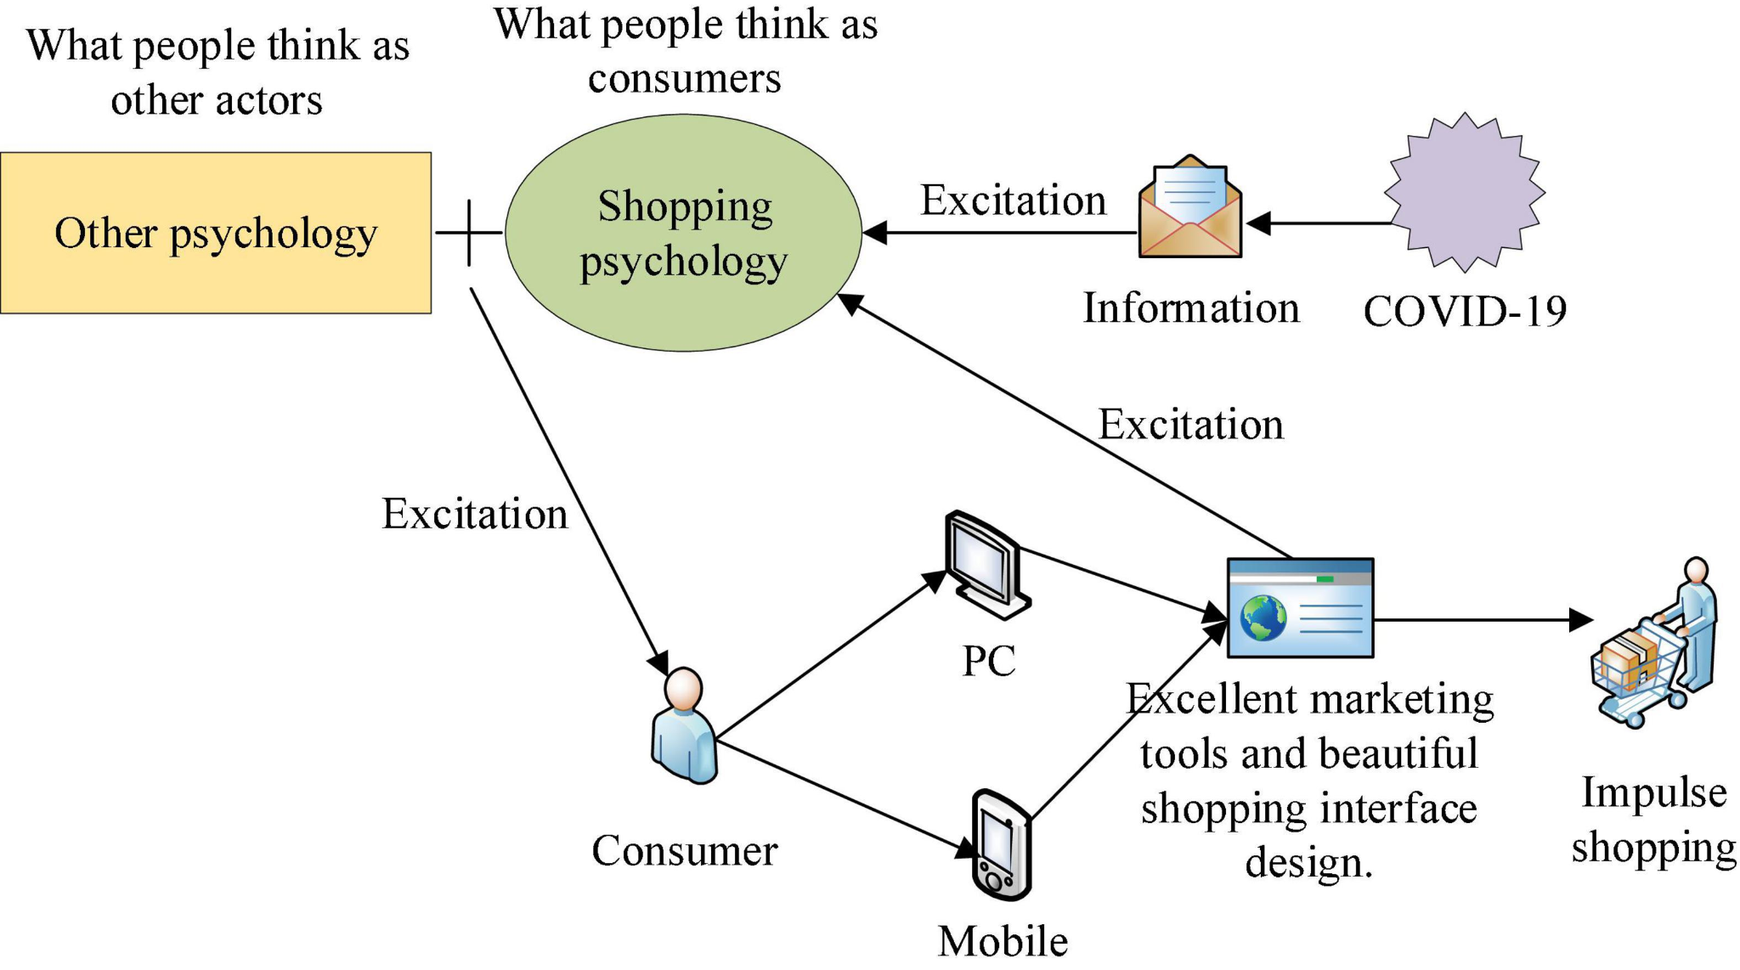
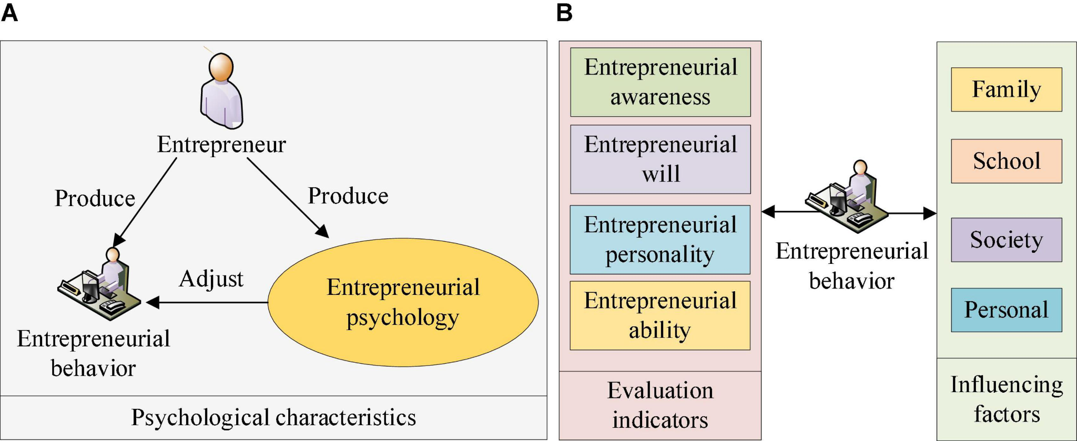
Literature Review
Key Drivers of Online Impulse Buying in S-Commerce
The drivers of “Online Impulse Buying Behavior” in S-commerce need to be clearly understood by both researchers and practitioners.
It is also highly dependent on the psychological factors of the customer: their emotions, moods, and perceptions.
Development of a Causal-Chain Framework
These methods have been effective in capturing consumer attitudes, behaviors, and the impact of various stimuli on impulse purchases.
The broad application of the S-O-R model in these studies underlines how external stimuli, such as marketing cues or social interactions, impact internal consumer states.
Notes:
2.1 Introduction
The study is used to establish an understanding of related research and various theories surrounding online shopping sites. It is expected to provide an understanding of the e-commerce environment and trends in the relevant field and key technologies that underpin the digital retail construct. This chapter discusses initial theoretical frameworks for consumer behaviour, discusses the effects of new technologies on the online buying process, and reviews such trends in website usability. The literature review section provides a theoretical framework based on an analysis of prior research examining the effects of online shopping platforms on consumer communication and behaviour.
2.2 Use of Literature
2.2.1 Antecedent of Online Impulse Buying Behavior in Social Commerce
“Impulse Customer Buying Behavior” has become very prominent in the digital commerce landscape, particularly in social commerce. “Social Commerce” is a subset of e-commerce that integrates social networking as well as user-generated content with online shopping. It creates a highly interactive environment that stimulates impulse purchases (Abdelsalam et al. 2020). The unique nature of S-commerce platforms is characterized by social interactions, peer influence, and seamless integration of shopping features. It has amplified the prevalence of impulse buying behaviors among consumers.
Key Drivers of Online Impulse Buying in S-Commerce
The drivers of “Online Impulse Buying Behavior” in S-commerce need to be clearly understood by both researchers and practitioners. The different literature identified key drivers of impulse buying, which can be broadly categorized into three groups: psychological, social, and technological factors. It is also highly dependent on the psychological factors of the customer: their emotions, moods, and perceptions. Easy access to products and instant satisfaction from purchases also contribute to unplanned buying. The attractiveness of the products, scarcity in supply, and personal recommendation also trigger such impulsive behavior.
Figure 2.2.1.1: Online Impulse Buying Behavior
(Source: frontiersin, 2024)
The social factors of S-commerce, such as peer recommendations, reviews, and endorsements, are great influencers of buying behavior. The need for social conformity or, rather, social proof, whereby people do what others do, tends to motivate many buyers into making impulse purchases. Also, the nature of these social interactions is the promotion of urgency and excitement, and this compels unplanned buying. It is facilitated by the technological design of the S-commerce sites including the user interface design, ease of navigation, integrated payment systems, one-click purchasing, and AI-driven product recommendations (Moon et al. 2021). It has personalized shopping experiences among others that combine to increase unplanned consumer purchasing.
Development of a Causal-Chain Framework
These methods have been effective in capturing consumer attitudes, behaviors, and the impact of various stimuli on impulse purchases. The broad application of the S-O-R model in these studies underlines how external stimuli, such as marketing cues or social interactions, impact internal consumer states. This study has casually generated the chain framework on “Online Impulse Buying in S-Commerce”, with a clear classification of inputs to the IBB: marketing stimuli and social influence; moderators: consumer traits and situational factors; mediators: emotional responses and cognitive processing; and outputs: purchase decisions. This gives a structured insight into the interaction among the various factors that drive impulse buying within the digital social environment.
Figure 2.2.1.2: Online Impulse Buying Behavior and Marketing Optimization Guided
(Source: frontiersin, 2024)
The authors of the reviewed studies themselves have emphasized the need for more studies to be conducted on under-researched areas. Including the long-term effect of online impulse purchases on consumer satisfaction and loyalty. The role emergent technologies like augmented reality play in shaping impulse buying behavior, and also S-commerce cross-cultural perspectives (Peña-García et al. 2020). In addition, future research needs to be directed at the construction of advanced models incorporating real-time data analytics that can provide better predictions and influence consumer behaviour in the dynamic S-commerce environment.

Slide 5
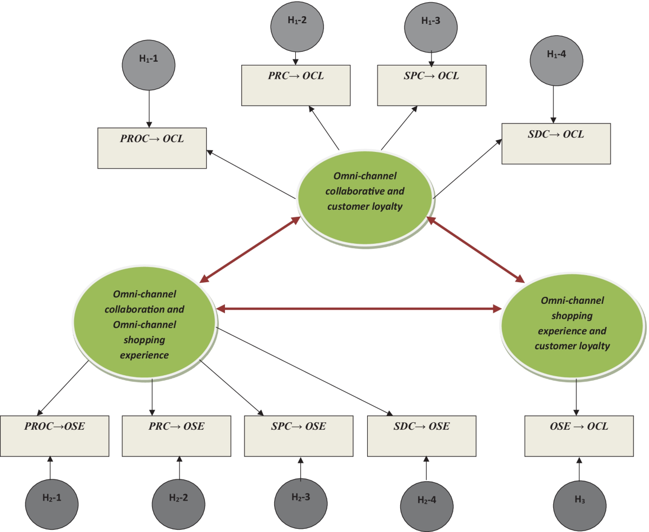
Literature Review Contd..
Impact of Technology-Related Quality and Context-Related Situational Benefits
The context-related situational benefits allude to those particular advantages that an e-channel offers based on the situation or context of a consumer.
Perceived Risks of Online Shopping
This is whereby the consumer receives a particular product with a perceived quality, functionality, and appearance.
There is one broad problem concerning the security of transactions primarily fraud and identity theft.
Notes:
2.2.2 Online Retailing Across E-Channels and E-Channel Touchpoints: Literature Review of Consumer Behavior in Multichannel E-Commerce Context
According to the multichannel and multi-touchpoint influences affecting the consumers, in today's dynamic e-commerce environment, multiple electronic channels or channels. The more buyers interact with online retailers through different kinds of devices and platforms, the more apparent the need to treat online retailing differently (Wagner et al. 2020). This section examines some of the empirical studies on how consumers engage with online retailing across channels and touchpoints for a deeper understanding of the multichannel e-commerce environment.
Gaining Insight into E-Channels and Touchpoints
E-channels are the various electronic platforms on which consumers engage in online shopping. The e-channel touchpoints are the different formats or interfaces of these channels, such as for shopping mobile apps, the web, and social media sites. All the e-channels and touchpoints elicit distinct impressions and values for consumers and therefore influence their shopping patterns and choices. During the studies, wide-ranging scenario profiles and patterns of how various consumer e-channels and points of contact were utilized in shopping were obtained by one online survey. An experimental study is more capable of providing valuable insights into what specific factors drive the choices and behaviors of consumers across the channels.
Figure 2.2.2.1: Omnichannel Customer Behavior
(Source: frontiersin, 2024)
“Online Retailing” is segmented into four clear categories of e-commerce, each with its associated “E-Channel Touchpoints”. These categories also indicate the multifarious ways in which consumers engage with online retailers and the need to tailor retail strategies to these varied touchpoints (Giao et al. 2020). The results can one approach work in online retailing for all, but the experiences and preferences of consumers also sharply vary across different e-channels and touchpoints.
Impact of Technology-Related Quality and Context-Related Situational Benefits
Technology-related quality is defined as the technical performance and user experience brought forth by the e-channel, such as website speed, mobile app functionality, and ease of navigation. The better the technology, the smaller the bridge to satisfaction, and increased use of the e-channel.
Figure 2.2.2.2: Impact of Customer Loyalty
(Source: SpringerLink, 2024)
The context-related situational benefits allude to those particular advantages that an e-channel offers based on the situation or context of a consumer. Mobile shopping apps are most convenient for on-the-move consumers while browsing via desktop websites could be more comprehensive (Koch et al. 2020). These situational benefits drive both choice and behavior and, hence, it is relevant for retailers to understand these contextual needs.
Implications for Retailers
The study indicated that retailers can diversify consumers' shopping experiences by offering a variety of e-channel touchpoints, which fall into different needs and preferences. Offering alternative formats for digital shopping can make the online customer journey more personalized and engaging. This multi-channel option is implied to increase customer satisfaction and, possibly, increase customers' likelihood to make purchases and repeat business.
2.2.3 Consequences of Product Risk: Perceived Satisfaction and Buying Propensity for Online Purchases
Along with the rapid growth of online shopping, significant changes have been noticed in consumer behavior. It has also invited a variety of perceived risks that can influence the purchasing decision (Tran, 2020). The section discusses in sequence the interlinking association between different categories of perceived “risk-products risk, financial risk, security risk, privacy risk, consumer satisfaction, as well as purchase intention online”.
Perceived Risks of Online Shopping
Perceived risk in the context of a buying decision implies uncertainty in a loss in the form of an adverse outcome. For an online customer, the perceived risks are multi-dimensional, including:
Product Risk: This is whereby the consumer receives a particular product with a perceived quality, functionality, and appearance.
Financial Risk: The risk of an employee or the supplier charging more than agreed in the payment process or charging incidences that are not clearly stated to be the risk in the payment process.
Security Risk: There is one broad problem concerning the security of transactions primarily fraud and identity theft.
Privacy Risk: This entails concern about how personal information might be used negatively against the customers or shared or disclosed without consent (Liu et al. 2020). These two risks can make a consumer decline to purchase something online, reduce overall satisfaction, and thus decrease this purchasing.
The measures that have been employed in this study have been as a result validated from other literature. CFA has been employed by authors for assessing the measurement model while SEM has been employed for assessing the conceptual models with a view of testing hypothesized relations.
Figure 2.2.3.1: Perceived Risks in Online Shopping
(Source: SpringerLink, 2024)
The research results showed the four perceived risks, namely the product, financial, security, and privacy risks, had a positive and significant impact on the consumers’ perceived satisfaction with online shopping. The study has flagged the most important antecedents of purchase intention to be product risk and privacy risk. The study showed that:
Product Risk: High product risk adversely affected perceived satisfaction as well as purchase intentions. A customer is not certain about a product's quality or performance.
Financial Risk: Whereas perceived financial risk affects perceived satisfaction, its impact is less overwhelming on purchase intentions (Lăzăroiu et al. 2020). Nevertheless, it does show the concern of financial loss about overall satisfaction with online shopping experiences.
However, perceived satisfaction has been significantly reduced by security and privacy risks. Moreover, privacy risk had a direct negative effect on purchase intentions. These findings emphasize the need to ensure security measures and clear privacy practices to engender consumer confidence.
Implications for Online Retailers
This study identifies perceived risk as an important factor that comes into question in online shopping behavior. Every retailer has to know that customers regard an online shopping platform with cognitive attitudes influenced by the perceived risks of a transaction. To decrease the occurrence of such risks, an online retailer has to:
Increase the quality of product information: Full, complete, and accurate information about the product, along with customer reviews and ratings about it, decreases product risk.
Stringent Security: Investment in advanced encryption technologies and secure payment gateways helps to mitigate concerns about security and financial risks.
Privacy Protection: A clear explanation of privacy policies, coupled with assurances regarding the protection of customer data, helps reduce anxiety stemming from privacy while increasing purchase intentions.
2.2.4 An Online Purchase Decision-Making Process and Retentive Consumer Behavior Assessment Model
The rapid proliferation of e-business platforms within the digital age has shaped the revolutionary changes in the consumer's shopping behavior. Therefore, upon the growing trend of online purchases, any business must identify the determinants that affect consumer satisfaction, purchase intentions, and repurchase behavior to retain consumers of their products or services (Petcharat and Leelasantitham, 2021). This section discusses a study that proposes a retentive consumer behavior assessment model, integrating the “Technology Acceptance Model” with the “Online Purchase Decision-Making Process” to examine such dynamics.
Theoretical Framework: Integration of TAM and Online Purchase Decision-Making Process
The proposed model extends the basic ideas of TAM, a widely used model. In an online shopping context, these translate into the quality and trustworthiness perceptions by consumers from an online platform, thus influencing their shopping behavior.
Figure 2.2.4.1: Consumer Decision Making Procedure
(Source: opentextbc, 2024)
This also includes the “Online Purchase Decision-Making Process” which specifies the stages that a consumer passes through in the process of deciding to purchase a product over the internet. These often encompass “problem recognition, decision making, evaluation of alternatives, information search, post-purchase behavior, as well as purchase decisions”. The study seeks to get a perfect understanding of consumers’ decision-making process in an online shopping context.
Key Factors: Trust and Quality
It identifies two critical input factors that help in understanding consumer behavior during an online shopping process, namely Trust and Quality.
Trust: To earn the ultimate goal of purchase, there is a need to win trust in an online shopping platform (Gu et al. 2021). This dimension refers to confidence in transaction security, dependability of a platform, and protection of one's personal information. Continuous buying behavior is activated once customers trust a platform.
Quality: the perceived quality of the online shopping platform in terms of website or app usability, accuracy in product descriptions, and efficiency in customer service. Such a high-quality platform, which would meet or surpass buyer expectations, would ultimately result in more repeat purchases.
Figure 2.2.4.2: Consumer Behavior of Online Stores
(Source: mdpi, 2024)
Data captured through questionnaires involved all factors in the conceptual model: trust, quality, and stages of the “Decision-Making Process”. The SEM is conducted to analyze the data and verify the causality between these factors. These results hint that this model explains the effects associated with e-business platforms: how trust and quality influence first-time purchase decisions or repeat purchases and recommendations (Alaimo et al. 2020). The consumers perceive a high level of trust as well as quality of an e business platform, it tends to complete a purchase and also re-purchase. This result cuts across various types of businesses such as, but not limited to, e-commerce, m-commerce, and e-commerce.
Implications for Online Retailers
These findings have very important implications for online retailers. If companies understand the drivers of satisfaction and loyalty among consumers, it is in a better position to strategize the design and development of online platforms. It can retain more consumers for satisfied consumers to make more purchases and recommend the platform to others.

Slide 6
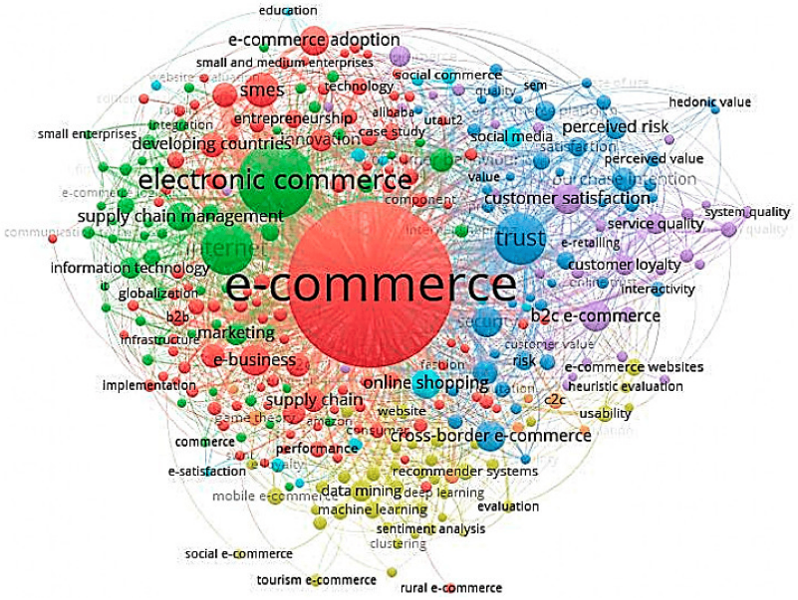
Literature Review Contd..
Consumer Marketing Strategy
E-commerce has significantly transformed how businesses, particularly consumer-oriented firms, market their products.
E-commerce simply is the process of selling and buying products through the internet, which is coupled with monetary transactions and electronic transfer of data.
Literature Gap
A majority of the existing research works have considered short-term dynamics, including an abrupt switch to online purchases.
There is also a lack of comprehensive analysis of the long-term psychological processes that may underlie changes in consumption patterns.
Notes:
2.2.5 Long-term Changes in Consumers' shopping behavior post-pandemic: An Exploratory Study
COVID-19 has brought new changes in the behaviors of consumers and how they engage through shopping facilities. Even though much effort has been devoted to studying the short-term impacts of the pandemic, far less attention has been devoted to the long-term changes. The data adopted in the research is of a qualitative nature which involved 159 study participants with the use of grounded theory analysis. This gains insights into how pandemic experiences have altered consumer behavior (Gu et al. 2021). One of the main implications of the research is that people who have had positive experiences during the pandemic have developed a positive change in sustainable consumption and online shopping. From the study, these nurtured a more positive sustainable, and environmental self-architecture that shaped their long-term purchasing behavior.
Figure 2.2.5.1: Changes in Shopping Behavior
(Source: emerald, 2024)
The pandemic limitations influenced these consumers to become more environmentally conscious and turn to online shopping as less environmentally negative than conventional shopping. These respondents had a higher FOMO score, loss aversion score, and rumination score than the other respondents. Shopping experiences during the pandemic also created a negative attitude which led to feelings of anxiety and uncertainty when shopping. Many of these consumers had fears, which are eliminated by behaving like a herd by following the purchasing trends set in the market. This group also commonly transitioned to buying products online due to concerns that are likely to be encountered when visiting physical stores (Zhao et al. 2020). The study identifies several important affective and psychological processes that are implicated in these long-term shifts in consumers’ behavior. Transforming positively predisposed consumers into sustainable selves shows how positive values and sentiments can be harnessed for sustainable consumption.
Figure 2.2.5.2: Impact on Online Shopping Behavior
(Source: mdpi, 2024)
On the other hand, the experiences of other consumers paint a picture of how psychological factors like FOMO and loss aversion cause shifts in buying behavior. It also entails the use of the internet for the purchase of goods as well as services like the purchase of groceries and other household items. The study also helps develop consumer behavior theory by proposing new antecedents that include self-identity, loss aversion, FOMO, and rumination that affect the change in long-term shopping behavior (Shen et al. 2021). These constructs provide a fresh angle on how the current COVID-19 crisis has affected consumers’ emotional/psychological state which in turn affects their retail decision-making. A major limitation of the study may be due to the exploratory research design that was used by the authors of the study and the small sample size. Future researchers build on these findings to strengthen the proposed conceptual model and consider the other factors that might contribute to long-term behavioral changes among consumers.
The research contributes to a deeper understanding of how shoppers have adjusted to the post-pandemic retail environment. The discoveries offer a foundation for future ponders to construct upon and give practical suggestions for retailers looking to address advancing consumer needs and inclinations in a quickly changing market.
2.2.6 The Sales Volume and Satisfaction in Forecasting Organic Products through Text Mining from Web Customer Reviews
The study takes into consideration the need to analyze consumer feedback on predicting sales and other significant factors about purchases based on text mining of “Web Customer Reviews” for organic product sales volume as well as levels of satisfaction. This is conducted using data gathered from the leading online shopping website, Taobao, for the analyses of customer reviews on organic products (Lyu and Choi, 2020). The study generalizes on customers' perceptions by categorizing online customer reviews using techniques such as sentiment analysis as well as LDA. The study is to predict the volume of organic product sales online. It made use of the analysis method from the neural network to forecast sales based on variables such as product price, delivery options, sales volume, customer reviews, and a product fan.
Figure 2.2.6.1: Market Research and Sales Forecasting
(Source: Fastercapital, 2024)
The study further applied regression analysis to assess the purchase intentions of the customers, thus providing further insight into what drives consumer behavior in buying organic products. Some of the critical factors that might indicate the purpose that leads to sales, like the packaging design, food quality, freshness, nutritional information, delivery risk, as well as source risk. Other critical factors established for volume are price discounts, the number of reviews by customers, and the number of fans of the product (Veleva and Tsvetanova, 2020). As such, the variables pointed out here are of much importance in making the customer buy organic products and some of the major considerations in improving the strategy.
Figure 2.2.6.2: Role of Market Research in Sales Forecasting
(Source: Fastercapital, 2024)
In this regard, the recommendation for improving online services as well as logistics to enhance the customer experience inculcates high “Consumer Satisfaction” as well as thus increases sales of organic products. Beyond these implications for sustainable development, there exists the broader implication for organic product marketing through effective online marketing, contributing to environmentally friendly consumer habits (Mariani and Wamba, 2020). The study predicts sales trends and identifies factors of influence affecting consumer satisfaction and purchase decisions by applying text mining techniques on customer reviews.
2.2.7 Consumer Marketing Strategy and E-Commerce in the Last Ten Years
E-commerce has significantly transformed how businesses, particularly consumer-oriented firms, market their products. E-commerce simply is the process of selling and buying products through the internet, which is coupled with monetary transactions and electronic transfer of data. In almost every aspect, technology advances, with e-commerce setting up shop right at the middle of new waves of marketing through easy access of information products and easier consumer decision-making (Rosário and Raimundo, 2021). Therefore, data-driven marketing strategies are in growing demand due to the understanding that businesses get from consumer behavior and tailor their approach according to customer needs. E-commerce and emphasis on digital marketing will spell a drastic shift for traditional marketing models as online platforms and social media marketing become essentially critical to consumer outreach. Social networks have become important in building the relationship between brands and consumers.
Figure 2.2.7.1: Online Customer Experience
(Source: frontiersin, 2024)
This is an area that has witnessed several developments based on what just happened. The study is still missing an investigation into every stream of e-commerce marketing and how it interconnects. To address the gaps and identify the emerging trends adopted in e-commerce marketing over the last decade, there needs to be a thorough literature review. The main objective is to synthesize findings from the existing literature and categorize emerging sub themes of consumer marketing strategies for e-commerce (Vander Schee et al. 2020). The current global market is highly competitive, and companies are now directed to use e-commerce sites and social networks to have a better understanding of consumer needs and behaviors. With online data and consumer interactions now, businesses come up with much more efficient marketing strategies with personalization, trust building, and customer engagement. Also, this being the case, companies have become necessities in any firm as a tool for a wider reach while cost efficiency is preserved.
Figure 2.2.7.2: Ecommerce Marketing Strategies
(Source: Ossisto, 2024)
One other critical theme that emerged in the literature review is innovative information-sharing forms and different ways of engaging consumers using e-commerce. Businesses then have a potential opportunity to carve out competitive advantages in value propositions that can use these tools correctly. This also remains one area of further research into interactions between various e-commerce marketing strategies and the possibility of knowledge development. E-commerce has indeed revolutionized the consumer marketing of any firm by increasing its online use and implementations of social networks to reach audiences (Muda and Hamzah, 2021). The findings have characterized e-commerce marketing over the past ten years, emphasizing the need for data-driven strategies, social media marketing, and further research into the changing interplay between these elements.
2.3 Literature Gap
A majority of the existing research works have considered short-term dynamics, including an abrupt switch to online purchases. Nevertheless, there is little systematic research on how such short-term alterations have converted into long-durable behavioral changes. There is also a lack of comprehensive analysis of the long-term psychological processes that may underlie changes in consumption patterns. Existing research includes short-term research on how the pandemic affected impulsive buying and online consumption, but few have explored those effects’ long-term impact (Xu and Li, 2020). The use of psychological factors like FOMO, loss aversion, and the emergence of a sustainable self-identity needs more research to determine essential effects on shopping behavior. The psychological processes underlying these behaviors are not yet fully understood, which means that there is a significant gap in knowledge about consumer psychology. Also, it is significant to research how these chronic shifts in behavior connect to novel technologies.
Some new technologies like artificial intelligence and augmented reality if introduced in e-shopping platforms may either enhance or even change the observed long-term trends. There is a lack of research in the current literature on how technological innovations can impact or transform consumer behavior in the world. Analyzing this interaction is crucial to understanding how customers’ experiences can be improved and behavior change managed through the use of technology (Sarker, 202). The literature also has one more shortcoming, namely the relative absence of consideration of various consumer segments. Most of the current studies combine results concerning various generations not paying attention to the fact that people of different generations. Also, cultures or economic status may perceive and respond to shifts in shopping behavior in a different way. This may involve a more careful analysis of these discrepancies, which may help to obtain a better understanding of the peculiarities of different segments of consumers.

Slide 7
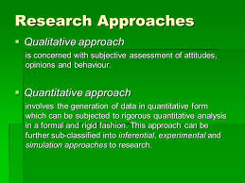
Methodology
Research Philosophy
The research philosophy applied in the case study that has been presented on online shopping.
This approach is commonly employed to highlight the relationships and trends that come out of measurable and numerical characteristics.
Research Approach
The type of research used in the case study on online shopping sites is the deductive type.
This approach entails placing hypotheses as methods to the theoretical models that have been proposed for theory.
Notes:
3.2 Research Philosophy
The research philosophy applied in the case study that has been presented on online shopping. This approach is commonly employed to highlight the relationships and trends that come out of measurable and numerical characteristics. This concerns the evaluation of data, whereby numbers are utilized to evaluate hypotheses about perceived behaviors and outcomes (Kuswanto et al. 2020). The strength of applying Positivism in this context lies in the fact that Positivism uses empirical analysis and data. Thus, Positivism helps with the analysis of online shopping behavior in detail and also offers a prescription based on the evidence.
3.3 Research Design
The design that has been applied to the case study of online shopping sites is descriptive. This approach intends to come up with a narrative form of explanation of current events based on some characteristics and behavior patterns that have probably been theorized to exist in the datasets provided. Therefore, in this study, descriptive Design has been adopted to examine how various features and technologies influence the shoppers’ behavior, with the help of exploratory data analysis (EDA) and customer segmentation techniques (Singh and Basu, 2023). This method makes it possible to determine characteristics of engagements and conversion rates and can act as a strong foundation for providing feasible solutions based on observation outcomes.
3.4 Research Approach
The type of research used in the case study on online shopping sites is the deductive type. This approach entails placing hypotheses as methods to the theoretical models that have been proposed for theory. Employing the deductive approach in this study, a research hypothesis is postulated in the form of a null hypothesis where it is assumed that some parts of design and technology influence the shopper's behavior, and empirical evidence is gathered to support the hypothesis (Lin et al. 2023). Therefore, it offers the right recommendations and recommendations that are simple to implement and improve the design and usability of the online shopping sites.

Slide 8
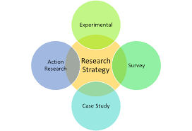
Methodology Contd..
Research Strategy
The method employed when conducting case studies on online shopping sites is the exploratory research method combined with the confirmatory research method.
Tools and Techniques Used
The process of exploring data, engineering features, clustering, and predictive modelling has been carried out using Python in this research.
Predictive modeling involves applying different ML algorithms, including “Linear Regression” as well as “Logistic Regression Models”, a “Random Forest model”, as well as “XGBoost Models”.
Notes:
3.5 Research Strategy
The method employed when conducting case studies on online shopping sites is the exploratory research method combined with the confirmatory research method. It includes Exploratory Data Analysis (EDA) to define the correlation and distribution of the used datasets and requires such libraries as Pandas, Matplotlib, and Seaborn (Bhatti et al. 2020). Therefore, common predictive modeling techniques of hypothesis testing and buyer prediction include Linear Regression, Logistic Regression, Random Forest, and XGBoost.
3.6 Tools and Techniques Used
The process of exploring data, engineering features, clustering, and predictive modelling has been carried out using Python in this research. Mainly, the tools used included the Pandas library for data manipulation and cleaning (Chen et al. 2021). Predictive modeling involves applying different ML algorithms, including “Linear Regression” as well as “Logistic Regression Models”, a “Random Forest model”, as well as “XGBoost Models”. The implementation of the model has been done using Scikit-learn; however, the best-performing models for classification have been provided by XGBoost in terms of efficiency and scalability. These improvements increased the accuracy of ML models. “Accuracy”, “Precision”, “Recall”, as well as “F1-score” have been used during model testing to determine how good the model is at performing. “Python” is an open and powerful platform through which all the techniques could be streamlined to enable an in-depth analysis of the behavior of online shopping.
3.7 Data Collection
The data that has been utilized for this study is taken from the UCI Machine Learning Repository’s “Online Retail”. The dataset is the transactional data of a UK-based retailing firm mainly selling certain specific gift items through an online platform. The total rows of the dataset exceed 500,000, which reflects purchases between December 2010 and December 2011. The dataset contains the following fields namely; “Invoice No, Article No, Description, Quantity, Invoice Date, Unit Price, Customer No, and Country”. The data is preprocessed to fill in missing values and remove duplicate variables to ensure that the data is sufficiently qualified for analysis (Febriyantoro, 2020). This data has been used to make use of different machine learning algorithms to build predictive models for forecasting customer actions and sales trends.
3.8 Data Analysis
Data analysis for this study has been subdivided into three important steps. These include EDA, customer segmentation, and predictive modeling. The process involved within EDA included summarizing the data, detection of outliers, and visualization of key characteristics which are the purchasing trend by customers, geographic sales, and average order value (Khan et al. 2022). Some of the examples of the algorithms entailing in the processing include “Random Forest”, “Linear Regression”, “XGBoost”, and “Logistic Regression”. The probability or likelihood of repeat purchases or repeat buying is expected behavior by the customers.
3.6 Ethical Consideration
As per the ethical considerations of the specific study under consideration, the study ensures legal requirements are met by anonymizing customers’ data in a way that the customers themselves cannot be easily recognizable (Cheung and To, 2021). The analysis and recommendations are meant to enhance the opportunities of users, without taking advantage of their data. Thus, adherence to these ethical standards ensures that the research is ethical in its approach and that any conclusions made and recommendations given are ethical and credible.

Slide 9
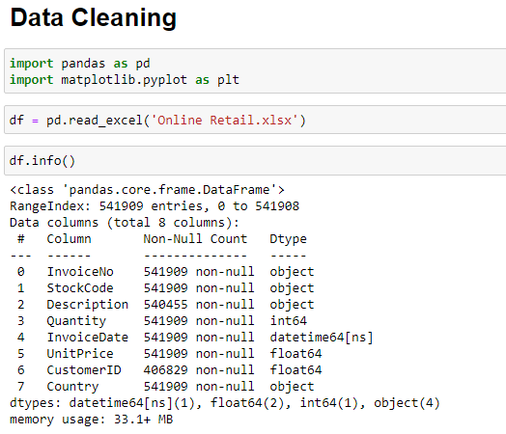
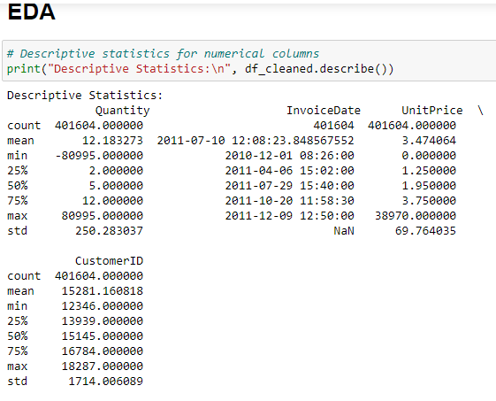
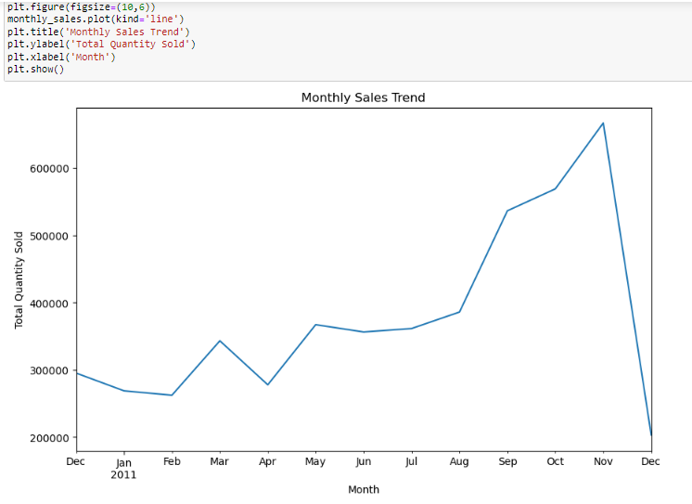
Result and Discussion
The above figure illustrates the flow for washing an online retail data set where data pre-processing and analysis are carried out in the Pandas program.
The above figure depicts descriptive values of the cleaned online retail data using the df. describe() method.
The above figure contains a line chart which represents the monthly sales in the online retail dataset.
Notes:
4.2 Result Analysis
Figure 4.2.1: Importing Libraries and Uploading Dataset
The above figure illustrates the flow for washing an online retail data set where data pre-processing and analysis are carried out in the Pandas program. It begins by importing necessary libraries and then reading the ‘Online Retail. xlsx’ file into a determined Data Frame called ‘df’ using the Pandas read_excel function. The df. inf() method is then used to obtain additional information regarding the structure of the datasets (Morid and Del Fiol, 2021). This is to get familiar with what the table entails which includes the data types of columns and the presence of null values in the dataset.
Figure 4.2.2: Cleaning the Dataset
The above figure shows the extent of data cleaning of the online retail dataset in its subsequent stages. Firstly, all rows, which contain missing data in the “CustomerID” or “Description” column of df are deleted using the df. dropna() method. After that, using df, equal rows are described and eliminated further on. drop_duplicates(). Such a systematic approach increases the reliability of the data achieved and, therefore, offers a suitable background for further analysis and modelling. This step is particularly important to ensure that the results that are obtained when it comes to the other steps in the analysis are both accurate and valid.
Figure 4.2.3: Descriptive Statistics
The above figure depicts descriptive values of the cleaned online retail data using the df. describe() method. For the numerical columns, it gives basic descriptive analytics such as count, mean, standard deviation, minimum, first quartile, median, third quartile, and maximum. It also includes the count of categorical variables like ‘InvoiceDate’, and ‘CustomerID’ which counts the frequency and uniqueness attached to specific categories (Cheng et al. 2021). This is useful in examining the general distribution of the dataset and any value outliers that may be observed to possibly need further examination or enhancement when creating the model.
Figure 4.2.4: Finding the top 10 most Sold Products
The above figure describes Data cleaning to find the 10 most frequently sold products from the cleaned online retail dataset. The grouped analysis addresses the level of ‘Description’ using the groupby() function showing the total ‘Quantity’ of each product which is then sorted using the sort_values() function. Finally, the head(10) function is used to display the ten most popular products. The results of this analysis can provide helpful information about the customers’ buying behaviours and can help with stock management, showing the top products in the given data set.
Figure 4.2.5: Graph for Month Sales Trend
The above figure contains a line chart which represents the monthly sales in the online retail dataset. The x-axis shows the period from December 2011 to December 2012, while the y-axis shows the total quantity that is sold in certain months. The line chart is equally useful for the analysis of the nature of sales volume since it simplifies the identification of trends or cyclical movements in sample data (Ghosh and Hosseini, 2021). For example, there is a marked rise in sales during November and December that is complemented by a drop in the serial from January to February.

Slide 10
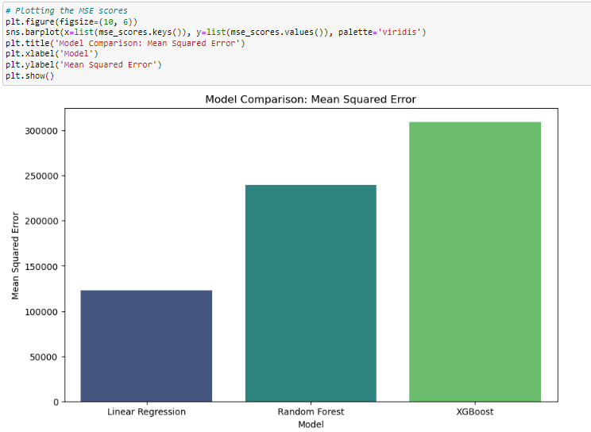
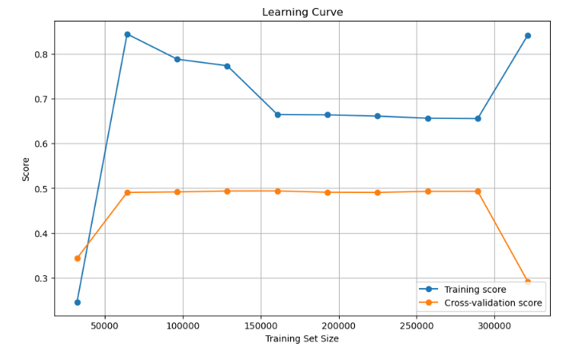
Result and Discussion Contd..
Key Findings
The analysis through online shopping websites reflected that there are very strong implications for understanding consumer behavior within a rapidly evolving digital landscape.
The research also emphasized the fact that these apparent features, such as the ability to get suggestions and customize products using dynamic pricing.
The features in K-means clustering of customers led to a better understanding of a variety of different purchasing behaviors, which can help guide marketing strategies for businesses.
Notes:
4.3 Key Findings
Figure 4.3.1: Logistic Regression Accuracy and Classification Report
The above figure also demonstrates the application of the logistic regression model for the tendency to buy in an online retail set. The process begins with the making of a new LogisticRegression() that fits to the training data – (X_train, y_train). Finally, an attempt is made to roughly predict using the testing data in feature vector form as X_test (Yakubu et al. 2022). The accuracy score obtained from the accuracy_score function shows a success rate of 0 percent which is very high 0.9998838.
Figure 4.3.2: Random Forest Accuracy and Classification Report
The above figure signifies the performance of the RandomForestClassifier, model while predicting the purchase behavior on an online retail dataset. Therefore, the initialized model contains 100 decision trees and the random state is 42 and the training set used is, X_train and y_train. Further, a forecast is made with the testing dataset (X_test). From the accuracy_score function, it gets ‘1’ meaning that it has an accuracy of 0% (Liu and Korobeynikova, 2020). Additionally, the function called classification_report gives more detail on the performance of the model in terms of precision, recall, f1-score, and support for both classes 0 and 1.
Figure 4.3.3: XG Boost Accuracy and Classification Report
The above image describes the flow of the XGBoost model for the purchase prediction in the online retail dataset and its general performance. It begins with defining the classifier as XGBClassifier() with the use_label_encoder as False and the eval_metric as ‘mlogloss’. The use of the model is trained through the training set (X_train, y_train) and tested through the test set (X_test). The following accuracy_score() is then used to assess the implemented model and an amazing accuracy of 0 is achieved 0. 9999502. This indicates that the XGBoost model is highly effective, accurate, and reliable for modelling purchase behavior in the context of the online retail dataset.
Figure 4.3.4: Linear Regression Model
The above figure also demonstates the use of the linear regression model on the online retail data set in a
scenario where the dependent variable Y is a continuous variable. Based on the LinearRegression() class from the scikit-learn library, the data set (X_train, y_train) is fit into the model then the test data (X_test) is passed through the predict method (AlFarraj et al. 2021). Mean squared error is calculated as the average squared difference between the actual values of the test set and the model’s predictions, equaling 123,138. 73. Moreover, the r2_score() function provides the R² of 0 as results 0.742.
Figure 4.3.5: Printing MSE Score
The above figure shows the final steps of model ‘E’ evaluation for the online retail dataset. The given code goes through each model mentioned in the ‘models’ dictionary, fits the models on the training data (X_train, y_train) and then predicts on the testing data (X_test). The mean_squared_error() function is used here to obtain the mean squared error (MSE) of each model to measure the difference between the actual and predicted values. The MSE Score of linear regression is 123137.795, Random Forest is 239729.165 and XG Boost is 309479.827.
Figure 4.3.6: Model Comparison based no Mean Squared Error
The above figure illustrates the mean squared error (MSE) for three predictive models: Out of the set models, Linear Regression, Random Forest and XGBoost are selected. The x-axis provides the model names while the y-axis provides the MSE results (Lim and Ali, 2022). This is true from the bar plot where XGBoost has taken the least MSE showing that it is the most accurate model to make predictions for the dataset. On the other hand, the Linear Regression model produces the highest MSE, which shows low accuracy in identifying the data patterns relative to the other models.
Figure 4.3.7: Linear Regression Residual Plot
The above image also shows the residual plot for the linear regression model of the dataset. On the x-axis are the predicted values while on the y-axis we have the residual or the actual minus the predicted values. The red dotted line indicates a zero residual line implying that the model predictions are perfectly fitting the outcome. A perfect residual plot should give a random distribution with the zero line and this means that there is no structure. In this case, the residual plot shows the variable spread near the lower predicted values and few points with large residuals.
Figure 4.3.8: Actual vs Predicted analysis for Random Forest
The above figure represents an actual versus prediction for the random forest model. The x-axis represents the actual values of the target variable while the y-axis represents the predicted values from the model. The red dashed line represents the prediction line on which actual and predicted values are in perfect correlation. The ideal scatter plot is one where the points of data are close to this line to depict the accuracy of predicted values. Here, the plot shows that all the points are distributed close to the straight line of perfect prediction but with negligible fluctuation.
Figure 4.3.9: Feature Importance for XG Boost
The above figure depicts the feature importance of the XGBoost model, where each feature points to the measure of importance in doing the prediction. The value displayed on the x-axis represents feature importance ranging from 0 to 1, and the features are displayed on the y-axis. The bar chart proves that the ‘Quantity’ feature gets a considerably higher importance value compared to the ‘Hour’ feature (Zhou et al. 2021). This means that ‘Quantity’, the number of products to be purchased, has more influence over the likely purchase behavior of a customer than the ‘Hour’ of purchasing. The greater importance of ‘Quantity’ implies that this factor is more influential in the model’s forecast than the time of the purchase.
Figure 4.3.10: Correlation Heatmap
The correlation heatmap gives the extent of the variables in the dataset which includes ’Quantity’, ‘TotalPurchase’, and ‘Hour’. It indicates a strong positive relationship between ‘Quantity’ and ‘TotalPurchase’, which means that as the ‘Quantity’ is high, the total purchase is also high. On the other hand, the heatmap gives a zero correlation between ‘Hour’ and the other two variables indicating that the time of purchase does not affect the quantity purchased or the total amount spent.
Figure 4.3.11: Learning Curve Based on the Models
The given image represents the accuracy of the machine learning model in terms of iterations. The horizontal axis is the training set size, and the vertical axis is the performance score of the model. The blue line denotes the training accuracy which usually rises as the amount of data in training increases since the model has a better fit which trains in the data set. The orange line is the cross-validation score that estimates the performance of the model in the unseen data set. The training score rises a little and then stabilizes meaning that the model is learning from the training data but not enhancing its ability to generalize.
4.4 Critical Analysis
The analysis of the case study concerning online shopping sites and consumer behavior revealed the importance of various aspects of ML and feature engineering in promoting customer engagement. It should also be noted that during the project, Python was used for data preprocessing, as well as EDA and modeling. Three key aspects stand out in the analysis:
Pre-processing and Techniques of Feature Extraction
The study used Python’s Pandas library to clean the data to increase the accuracy and validity of the study. Features engineering has produced helpful metrics, such as the "TotalPurchase," and only the records and fields with incomplete information were either eliminated or left unfilled. Thus, by emphasizing the meticulous data-cleaning procedure required to activate the model-related functionalities, this approach improved the validity of future research.
Customer Segmentation and Predictive Modeling
The quantitative approach involved the K-means clustering of customers with purchase behavior classified based on normalized data for equal contribution of the features. Among the models built in this project namely Logistic Regression, Random Forest, XGBoost, and Linear Regression, an accuracy check was done (Yakubu et al. 2022). The result shows that the XGBoost model is the most accurate with the lowest MSE which means that it performs the highest prediction accuracy of the purchase intention.
Model Evaluation and Insights
The learning curves pointed to that the models stood to gain from the training data but equally did not completely overfit on the training data, a sign of good generality to unseen data. The quantitative analysis of feature importance also showed that ‘Quantity’ was more important than temporal features, meaning that product demand is more crucial than time to buy products.
Through the study, the utilization of data mining using Python programming language is explained on how it can enhance the performance of an online shopping site through customer analysis.

Slide 11
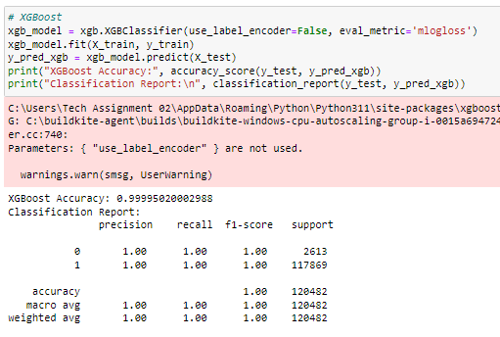
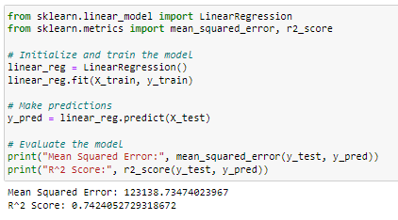
Evaluation and Conclusion
Critical evaluation
The study conducted about consumer behaviour in online shopping is very helpful about the given factors about the design, functions, A.I and A.R.
The evaluation process of the approaches, such as EDA and other predicting models, show that those are useful in proving the consumer’s patterns.
Summary of the Achievement
This research achieves its key objective regarding the effects of various attributes and technologies on online shopping behaviour.
By applying its methodological design effectively, the study might have identified a few critical factors for engagement and satisfaction with e-commerce.
Notes:
5.1 Critical evaluation
The study conducted about consumer behaviour in online shopping is very helpful about the given factors about the design, functions, A.I and A.R. The evaluation process of the approaches, such as EDA and other predicting models, show that those are useful in proving the consumer’s patterns. However, this study is not without some predisposed limitations in data collection since it works with transactional data culled from a single point of retail sale. This reliance may not properly capture the spread of these behaviours across different demographics and other shopping contexts. It is also important to point out an inherent limitation in the translational generalization of the findings from analysis to the overarching e-commerce environment. The study achieved its aim of finding out key factors that have an impact on customers’ engagement and satisfaction. However, it recommends that future studies incorporate quantitative methods like; conducting survey interviews to delve deeper into the psychological angle of the factors affecting online shopping. Also, the results assert the need for e-commerce strategies to be responsive to the constant challenges of consumer preferences within the ever-changing technological environment. It may be beneficial to undertake further studies that may fill the gaps in the identification of factors that affect consumer’s decisions on online shopping.
5.2 Summary of the Achievement
This research achieves its key objective regarding the effects of various attributes and technologies on online shopping behaviour. By applying its methodological design effectively, the study might have identified a few critical factors for engagement and satisfaction with e-commerce. This underpins the techniques in machine learning, including Linear Regression, Random Forest, and XGBoost, which are applied to predict certain consumer behaviours and trends across the internet shopping landscape. Along the same lines, this study highlighted personalization and user-centric design and their roles in improving the entire online shopping experience as a whole. Using the elaboration of results, the study showed that the experience customized to a specific individual and intuitive interface improved customer satisfaction and engagement. This research is also pointed to complement the existing knowledge of research by determining literature gaps about the long-term implications of developing new technologies in e-commerce.
The solution offers insightful action that helps businesses improve their online engagement. The implementation strategies of these technologies give in-depth information regarding changing consumer behaviour, consequently making shopping much more attractive to customers. By bringing together the technical advances and the preferences of the customers, a business can establish more intense relationships with its customers.
5.3 Linkage to Objective
The research addressed stated objectives very effectively by showing a clear relationship between design and functionality and their significant implications on customer experience and choice. This is accomplished by showing the interaction between site usability and consumer satisfaction through a detailed analysis of quantitative data related to both. Under another objective, the emerging technology that was going to be probed for use includes the use of artificial intelligence (AI) and augmented reality (AR). The results reveal that these emerging technologies strongly improve user experiences and interactions. The third objective had to do with identifying the determinants of consumer interaction. Analysis of the dataset could indicate trends and preferences across a variety of demographic groups while providing insights into the diverse needs of the online shopper. The fourth objective, predictive modelling techniques were used in a comparison of the differential effectiveness of various features around user engagement. This indicates outcomes for some strategies analyzed as better than others.
Lastly, it emerged organically from the investigation: the fifth objective-practical recommendations for online shopping websites. It has aligned with the initial objectives of the study, underlining the applicability of results but also exposing to real-world possibilities of practical implementation in improving online shopping experiences.

Slide 12
Evaluation and Conclusion Contd..
Research Recommendation
Based on the findings, some recommendations to e-commerce companies on how to upgrade their online platforms could be given as follows.
First, these businesses try to enhance the user experience through intuitiveness and personalization features.
User experience is the backbone of increasing customer engagement and satisfaction.
Future Work
Future studies are conducted as longitudinal research with special attention to how consumer behaviour evolves, especially with continually integrated new technologies into e-commerce.
Studies are urged to expand the dataset of different retailers in different sectors to achieve a better perspective on shopping behaviour.
Notes:
5.4 Research Recommendation
Based on the findings, some recommendations to e-commerce companies on how to upgrade their online platforms could be given as follows. First, these businesses try to enhance the user experience through intuitiveness and personalization features. User experience is the backbone of increasing customer engagement and satisfaction. The AI-driven recommendation system should thus be put into use because it has the effect of heightening personalization, hence boosting conversion rates. Businesses also need to consider investing in AR technology to augment a more immersive shopping experience through the visualization of the product in the environment of the customer. This aspect of online shopping is quite an interesting activity. As consumers change preferences over time, businesses monitor consumer behaviour constantly because trends are changing pretty fast for the sake of online shoppers. Through this monitoring, businesses could adjust their strategies accordingly. This goes ahead to allow businesses to change their platforms in light of actual consumer needs and experiences, as relevance can be ensured in a competitive marketplace.
Integrating this educational content with new technologies and additional features of shopping is productive because it empowers consumers, thus building trust. These initiatives promote increased customer loyalty and sales, helping to make the online shopping experience more successful.
5.5 Future Work
Future studies are conducted as longitudinal research with special attention to how consumer behaviour evolves, especially with continually integrated new technologies into e-commerce. Moreover, investigation of psychological factors might elucidate online shopper decisions to understand more about what triggers consumer motives and preferences. Studies are urged to expand the dataset of different retailers in different sectors to achieve a better perspective on shopping behaviour. Complementary Qualitative Methods A stratified sample could be used for focus groups or in-depth interviews to complement the purely quantitative findings. This approach brings to light insights into the nature of the emotional and cognitive events surrounding online shopping that merely quantitative data alone might fail to uncover. Another avenue for investigation is the study on the role of social commerce and user-generated content within the context of consumer behavior. Also, social media sites are being used as channels to shop. This is critical for the e-commerce strategy is how these dynamics take shape into actual purchasing decisions. Only through continued exploration of such themes, studies are capable of feeding into a fuller understanding of the forces of influence shaping the future in any attempt at online shopping.

Slide 13
REFERENCES LIST
Abdelsalam, S., Salim, N., Alias, R.A. and Husain, O., 2020. Understanding online impulse buying behavior in social commerce: a systematic literature review. Ieee Access, 8, pp.89041-89058.
Alaimo, L.S., Fiore, M. and Galati, A., 2020. How the COVID-19 pandemic is changing online food shopping human behavior in Italy. Sustainability, 12(22), p.9594.
Bhatti, A., Rehman, S.U., Kamal, A.Z. and Akram, H., 2020. Factors effecting online shopping behaviour with trust as moderation. Jurnal Pengurusan, 60, pp.109-122.
Chen, J.S., Le, T.T.Y. and Florence, D., 2021. Usability and responsiveness of artificial intelligence chatbot on online customer experience in e-retailing. International Journal of Retail & Distribution Management, 49(11), pp.1512-1531.
Notes:
Cheung, M.F. and To, W.M., 2021. The effect of consumer perceptions of the ethics of retailers on purchase behavior and word-of-mouth: The moderating role of ethical beliefs. Journal of Business Ethics, 171(4), pp.771-788.
Chopra, A., Avhad, V. and Jaju, A.S., 2021. Influencer marketing: An exploratory study to identify antecedents of consumer behavior of millennial. Business Perspectives and Research, 9(1), pp.77-91.
Fadillah, F. and Kusumawati, N., 2021. Factors Affecting Makeup Products Online Impulsive Buying Behavior on TikTok. Proceeding Book of The 6th ICMEM, no. August, pp.11-13.
Febriyantoro, M.T., 2020. Exploring YouTube Marketing Communication: Brand awareness, brand image and purchase intention in the millennial generation. Cogent Business & Management, 7(1), p.1787733.
Giao, H., Vuong, B. and Quan, T., 2020. The influence of website quality on consumer’s e-loyalty through the mediating role of e-trust and e-satisfaction: Evidence from online shopping in Vietnam. Uncertain supply chain management, 8(2), pp.351-370.
Gu, S., Ślusarczyk, B., Hajizada, S., Kovalyova, I. and Sakhbieva, A., 2021. Impact of the COVID-19 pandemic on online consumer purchasing behavior. Journal of Theoretical and Applied Electronic Commerce Research, 16(6), pp.2263-2281.
Gu, S., Ślusarczyk, B., Hajizada, S., Kovalyova, I. and Sakhbieva, A., 2021. Impact of the COVID-19 pandemic on online consumer purchasing behavior. Journal of Theoretical and Applied Electronic Commerce Research, 16(6), pp.2263-2281.
Gupta, A.S. and Mukherjee, J., 2022. Long-term changes in consumers' shopping behavior post-pandemic: an exploratory study. International Journal of Retail & Distribution Management, 50(12), pp.1518-1534.
Ismagilova, E., Slade, E.L., Rana, N.P. and Dwivedi, Y.K., 2020. The effect of electronic word of mouth communications on intention to buy: A meta-analysis. Information Systems Frontiers, 22, pp.1203-1226.
Joshi, R. and Garg, P., 2021. Role of brand experience in shaping brand love. International Journal of Consumer Studies, 45(2), pp.259-272.
Khan, S., Zaman, I., Khan, M.I. and Musleha, Z., 2022. Role of Influencers in Digital Marketing: The moderating impact of follower’s interaction. Gmjacs, 12(1), pp.15-43.
Koch, J., Frommeyer, B. and Schewe, G., 2020. Online shopping motives during the COVID-19 pandemic—lessons from the crisis. Sustainability, 12(24), p.10247.
Kuswanto, H., Pratama, W.B.H. and Ahmad, I.S., 2020. Survey data on students’ online shopping behaviour: A focus on selected university students in Indonesia. Data in brief, 29, p.105073.
Lăzăroiu, G., Neguriţă, O., Grecu, I., Grecu, G. and Mitran, P.C., 2020. Consumers’ decision-making process on social commerce platforms: Online trust, perceived risk, and purchase intentions. Frontiers in Psychology, 11, p.890.
Lee, C.H. and Chen, C.W., 2021. Impulse buying behaviors in live streaming commerce based on the stimulus-organism-response framework. Information, 12(6), p.241.
Lin, C.T., Chen, C.W., Wang, S.J. and Lin, C.C., 2023. The influence of impulse buying toward consumer loyalty in online shopping: a regulatory focus theory perspective. Journal of Ambient Intelligence and Humanized Computing, pp.1-11.
Liu, F., Lim, E.T., Li, H., Tan, C.W. and Cyr, D., 2020. Disentangling utilitarian and hedonic consumption behavior in online shopping: An expectation disconfirmation perspective. Information & Management, 57(3), p.103199.
Lyu, F. and Choi, J., 2020. The forecasting sales volume and satisfaction of organic products through text mining on web customer reviews. Sustainability, 12(11), p.4383.
Ma, L. and Sun, B., 2020. Machine learning and AI in marketing–Connecting computing power to human insights. International Journal of Research in Marketing, 37(3), pp.481-504.
Mariani, M.M. and Wamba, S.F., 2020. Exploring how consumer goods companies innovate in the digital age: The role of big data analytics companies. Journal of Business Research, 121, pp.338-352.
Moon, J., Choe, Y. and Song, H., 2021. Determinants of consumers’ online/offline shopping behaviours during the COVID-19 pandemic. International journal of environmental research and public health, 18(4), p.1593.
Muda, M. and Hamzah, M.I., 2021. Should I suggest this YouTube clip? The impact of UGC source credibility on eWOM and purchase intention. Journal of Research in Interactive Marketing, 15(3), pp.441-459.
Peña-García, N., Gil-Saura, I., Rodríguez-Orejuela, A. and Siqueira-Junior, J.R., 2020. Purchase intention and purchase behavior online: A cross-cultural approach. Heliyon, 6(6).
Peña-García, N., Gil-Saura, I., Rodríguez-Orejuela, A. and Siqueira-Junior, J.R., 2020. Purchase intention and purchase behavior online: A cross-cultural approach. Heliyon, 6(6).
Petcharat, T. and Leelasantitham, A., 2021. A retentive consumer behavior assessment model of the online purchase decision-making process. Heliyon, 7(10).
Rosário, A. and Raimundo, R., 2021. Consumer marketing strategy and E-commerce in the last decade: a literature review. Journal of theoretical and applied electronic commerce research, 16(7), pp.3003-3024.
Saoula, O., Shamim, A., Suki, N.M., Ahmad, M.J., Abid, M.F., Patwary, A.K. and Abbasi, A.Z., 2023. Building e-trust and e-retention in online shopping: the role of website design, reliability and perceived ease of use. Spanish Journal of Marketing-ESIC, 27(2), pp.178-201.
Sarker, I.H., 2021. Data science and analytics: an overview from data-driven smart computing, decision-making, and applications perspective. SN Computer Science, 2(5), p.377.
Shen, B., Tan, W., Guo, J., Zhao, L., and Qin, P., 2021. How to promote user purchases in the metaverse? A systematic literature review on consumer behavior research and virtual commerce application design. Applied Sciences, 11(23), p.11087.
Singh, K. and Basu, R., 2023. Online consumer shopping behaviour: A review and research agenda. International Journal of Consumer Studies, 47(3), pp.815-851.
Svatosova, V., 2020. The importance of online shopping behavior in the strategic management of e-commerce competitiveness. Journal of Competitiveness, 12(4), p.143.
Tran, V.D., 2020. The relationship among product risk, perceived satisfaction, and purchase intentions for online shopping. The Journal of Asian Finance, Economics and Business, 7(6), pp.221-231.
Vander Schee, B.A., Peltier, J. and Dahl, A.J., 2020. Antecedent consumer factors, consequential branding outcomes and measures of online consumer engagement: current research and future directions. Journal of Research in Interactive Marketing, 14(2), pp.239-268.
Veleva, S.S. and Tsvetanova, A.I., 2020, September. Characteristics of the digital marketing advantages and disadvantages. In IOP Conference Series: Materials Science and Engineering (Vol. 940, No. 1, p. 012065). IOP Publishing.
Wagner, G., Schramm-Klein, H. and Steinmann, S., 2020. Online retailing across e-channels and e-channel touchpoints: Empirical studies of consumer behavior in the multichannel e-commerce environment. Journal of Business Research, 107, pp.256-270.
Xu, X., Wu, J.H. and Li, Q., 2020. What drives consumer shopping behavior in live-streaming commerce? Journal of electronic commerce research, 21(3), pp.144-167.
Yakubu, B., Salamzadeh, A., Bouzari, P., Ebrahimi, P. and Fekete-Farkas, M., 2022. Identifying the key factors of sustainable entrepreneurship in the Nigerian food industry: The role of media availability. Entrepreneurial Business and Economics Review, 10(2).
Zhang, L., Anjum, M.A. and Wang, Y., 2024. The impact of trust-building mechanisms on purchase intention towards metaverse shopping: the moderating role of age. International Journal of Human–Computer Interaction, 40(12), pp.3185-3203.
Zhao, Y., Wang, L., Tang, H. and Zhang, Y., 2020. Electronic word-of-mouth and consumer purchase intentions in social e-commerce. Electronic Commerce Research and Applications, 41, p.100980.

Slide 14
Thank You!

